Slide 1

The Reconfigurable Future of Accelerators (or Wishful Thinking?)
Tulika Mitra National University of Singapore
Keynote at 35th International Conference on Field-Programmable Logic and Applications (FPL) 2025

Slide 2


Slide 3
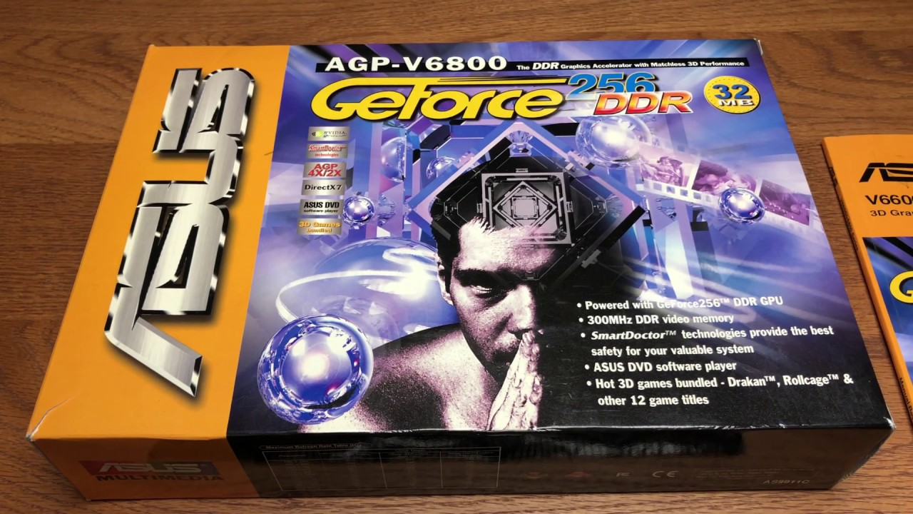
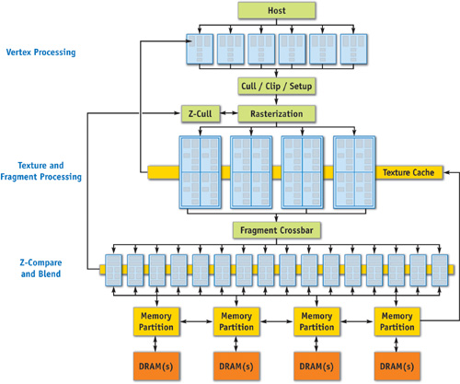
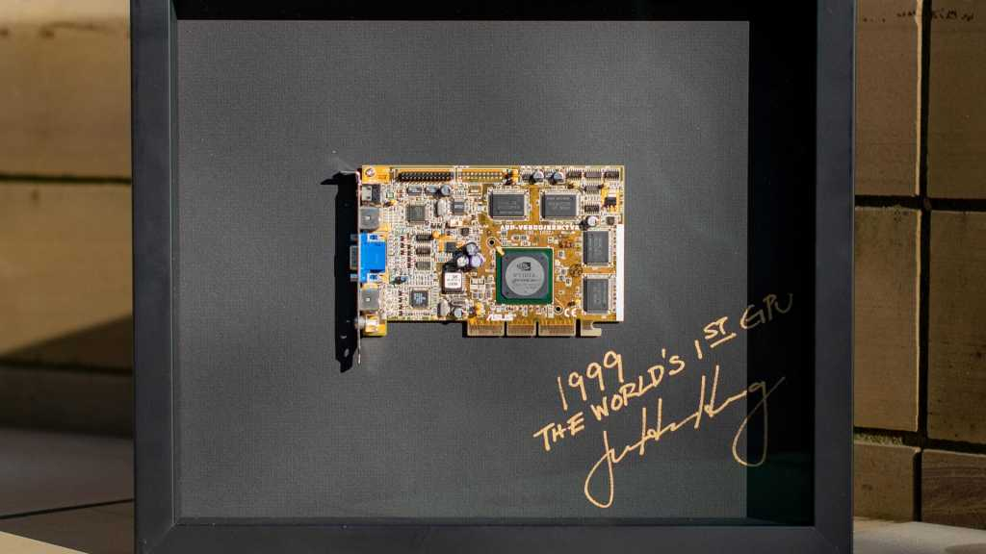
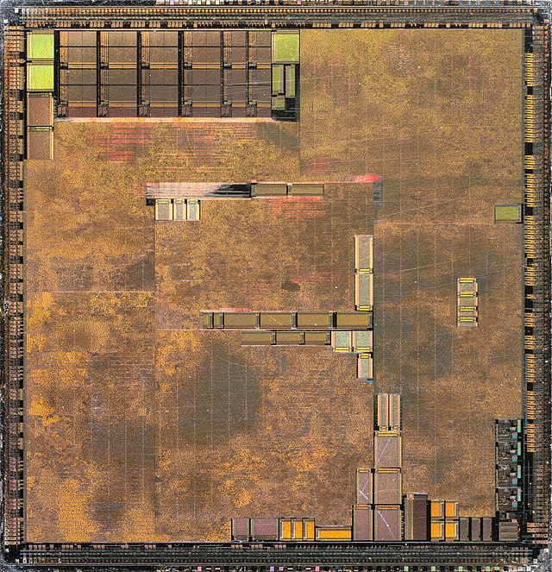
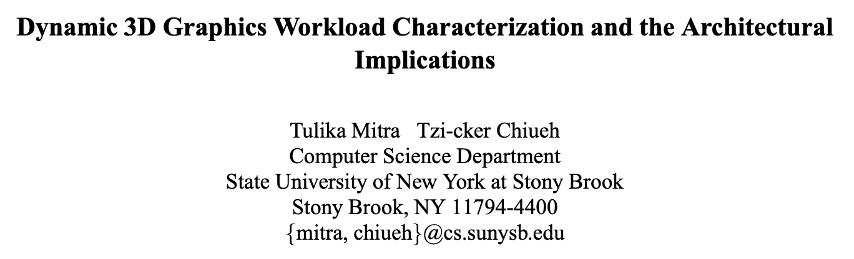

World’s First GPU Accelerator (1999)
TSMC 220 nm
17 million transistors
32-64 MB memory
4.8 GB/s memory bandwidth 13 W power

Slide 4
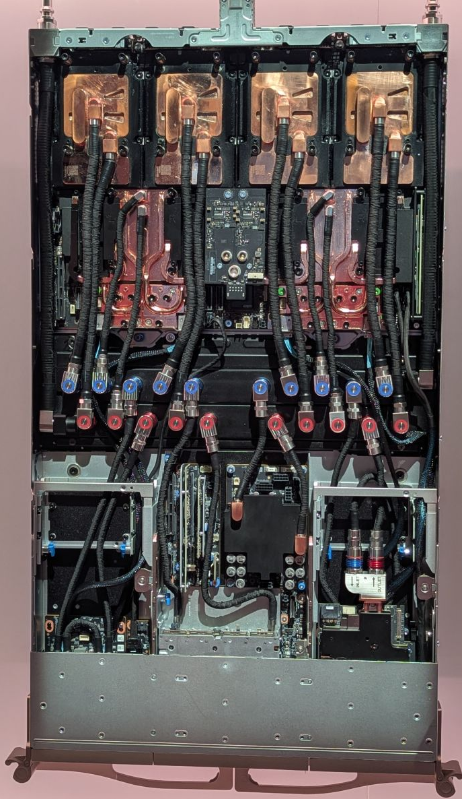
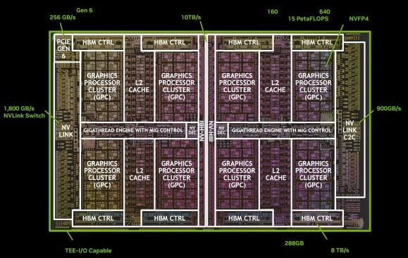
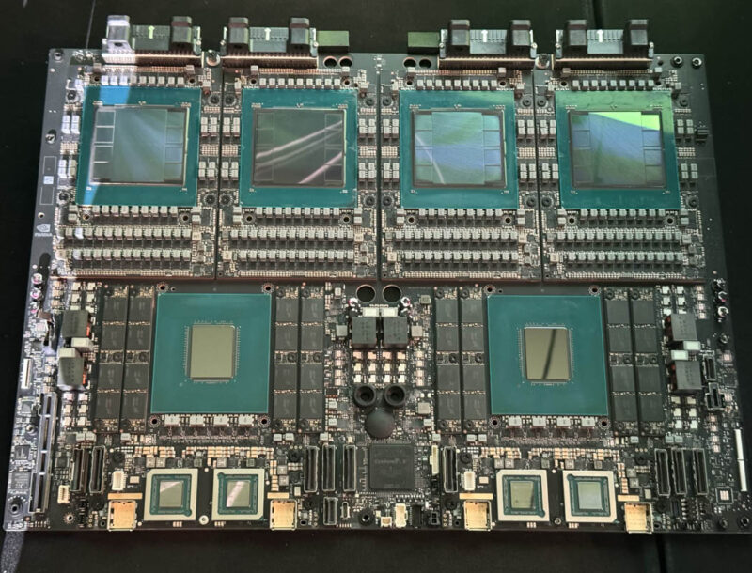
GPU in 2025: Blackwell Ultra B300 AI Accelerator
 | 1999 | 2025
Technology Node | TSMC 220nm | TSMC Custom 4NP (5nm)
Transistors | 17 million | 208 billion
Memory per GPU | 32-64 MB | 288 GB
Memory BW | 4.8 GB/s | 8 TB/s
Power per GPU | 13 W | 1400 W

Slide 5
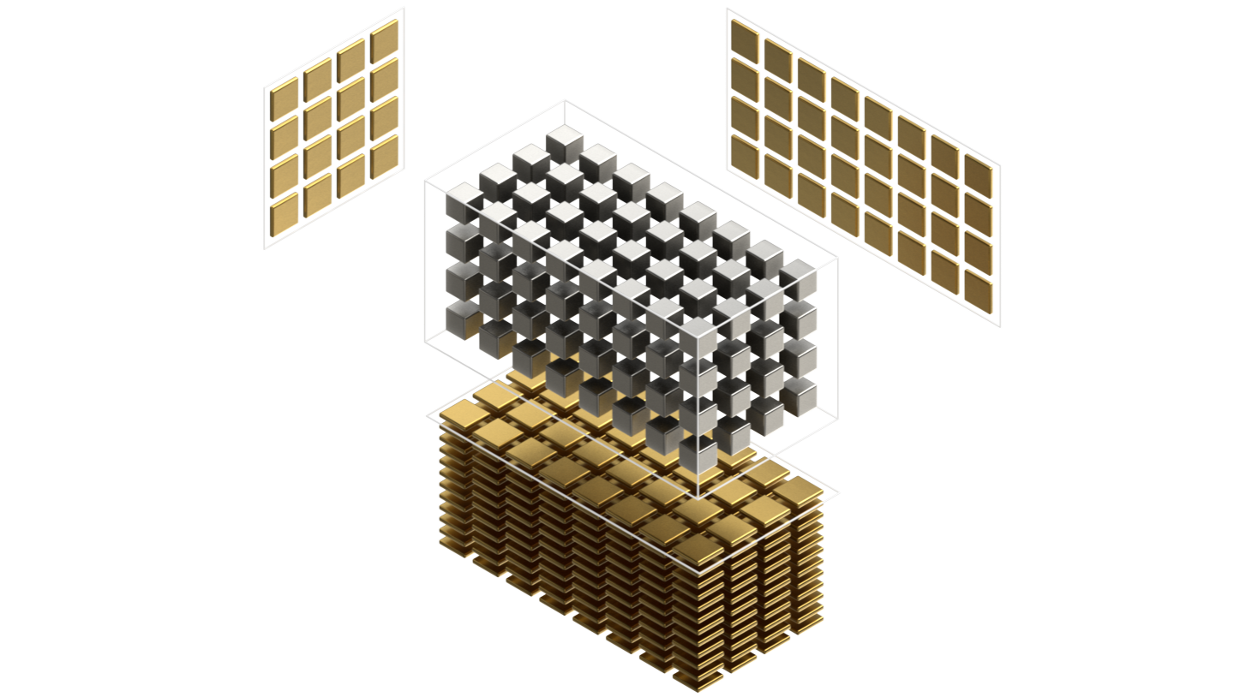
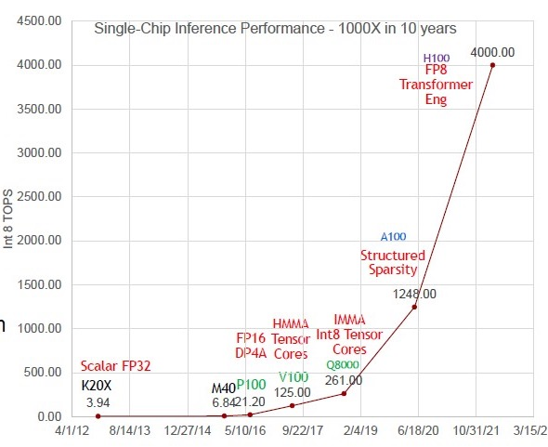
GPU Architectural Advances
B200
20,000
Nvidia GPU Tensor Cores
Blackwell gains w.r.t. K20X
﻿﻿Number Representation (~32x)
FP32, FP16, Int8, FP4
Complex Instructions (~12.5×)
DP4, HMMA, IMMA
﻿﻿Technology node (~3x)
28m, 16nm, 7nm, 5nm, 4nm
Die Size 2x
Source: Nvidia; Bill Dally

Slide 6
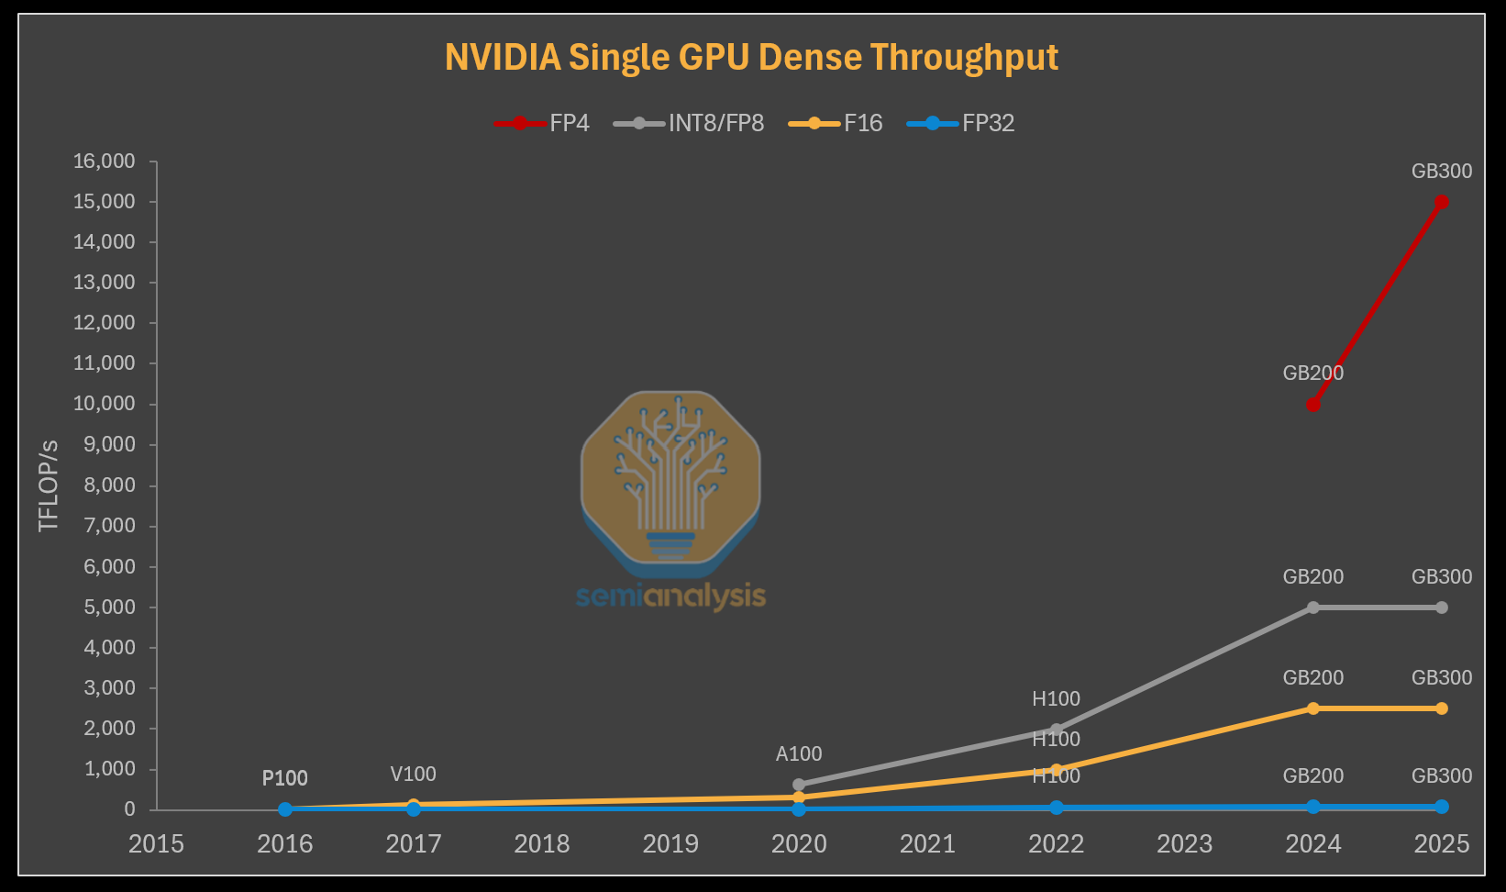

Slide 7
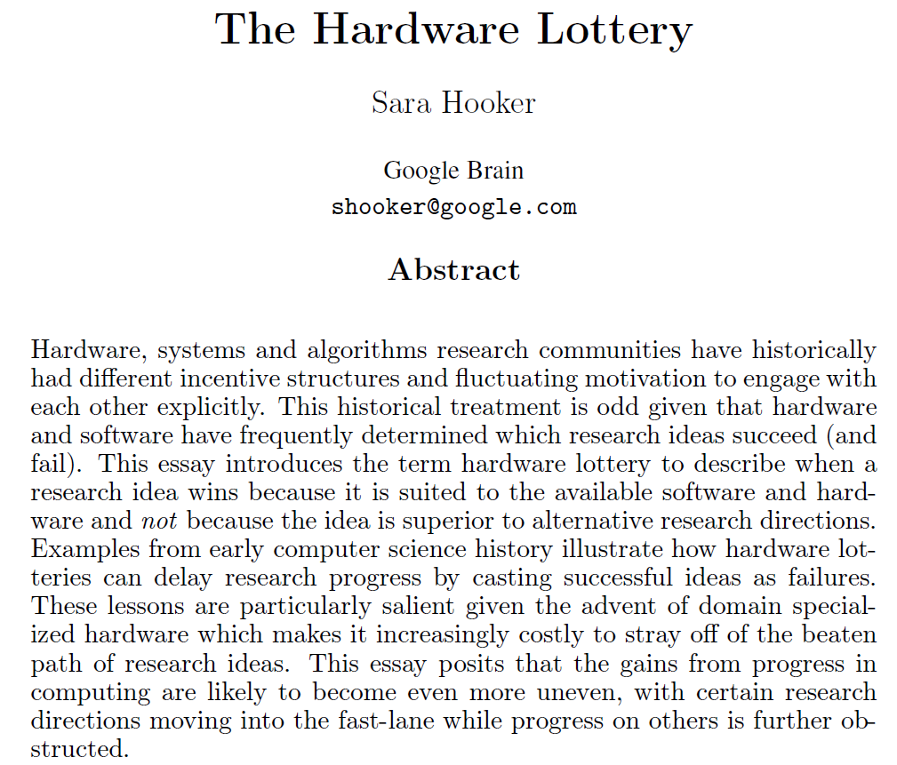
Transformer Architecture is ideally matched with GPUs

Slide 8
GPU dominance among AI data center accelerators
In AI data center chips, GPUs dominate by revenue (>80%)
In broader data-center accelerator market (all workloads, not just AI), GPU’s share is less but still significant
AI is the dominant workload today and likely in the future
Reconfigurable future of accelerators seems wishful thinking
But….

Slide 9
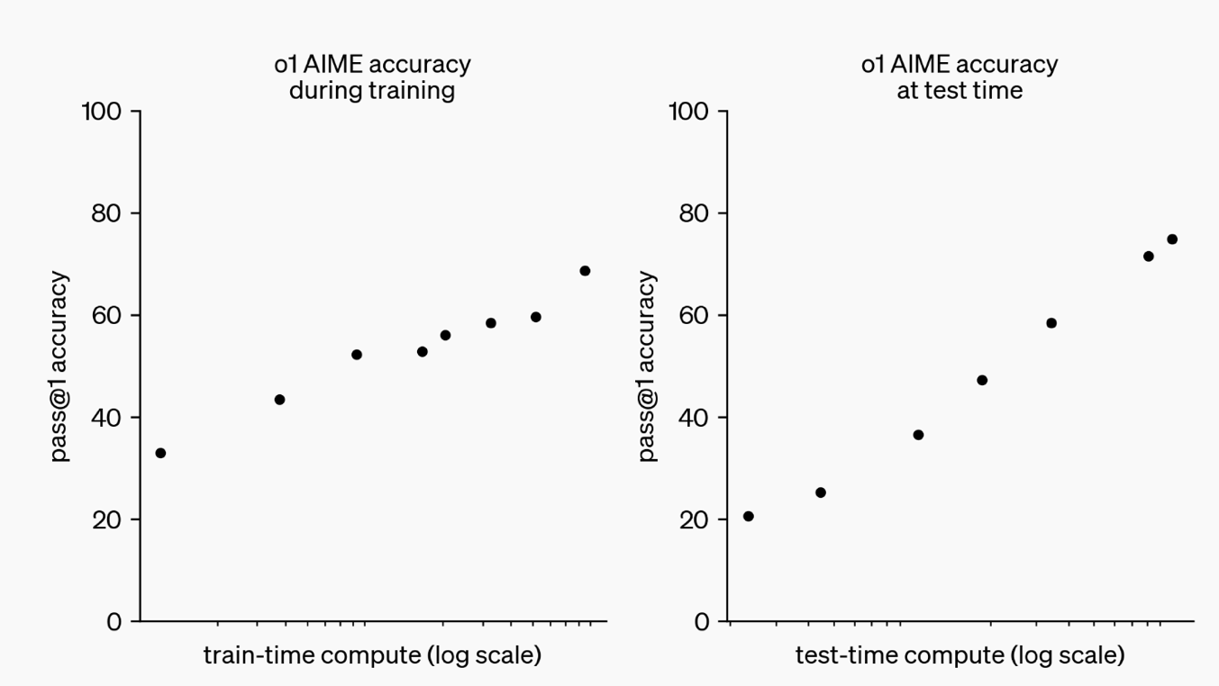
Inference has become the key workload Test-time compute scaling: “Reasoning” LLM
Test-time compute allows the model to engage in extensive
chain-of-thought reasoning during inference, enhancing accuracy
Source: OpenAI

Slide 10
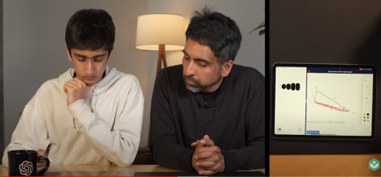




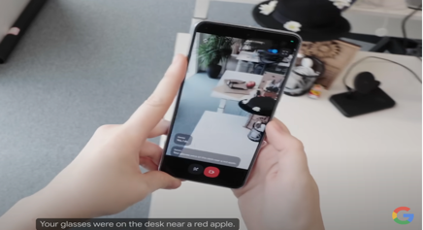




Emergence of Native Multimodal LLMs AI inference is moving to the edge
LLM
ChatGPT AI math tutoring with voice and video
Google Gemini personal AI assistant with voice and video
Seamless interaction with physical world via integration of multimodal data
Perfect foundation for embodied intelligence

Slide 11
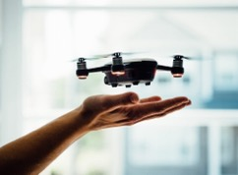
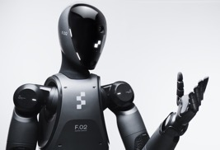

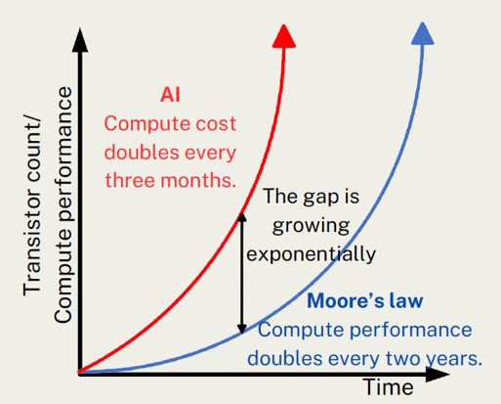
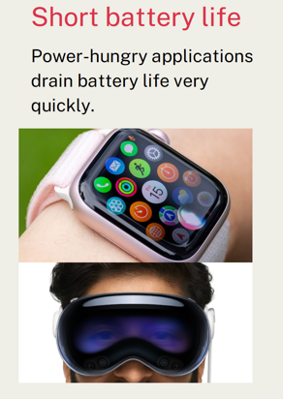
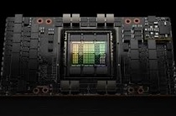
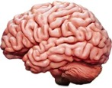

AI Compute Challenge
AI compute gap
AI power gap
GPU
700W
Brain 20W
Watch 1W
Need faster, more energy-efficient, and cheaper AI inference accelerators

Slide 12
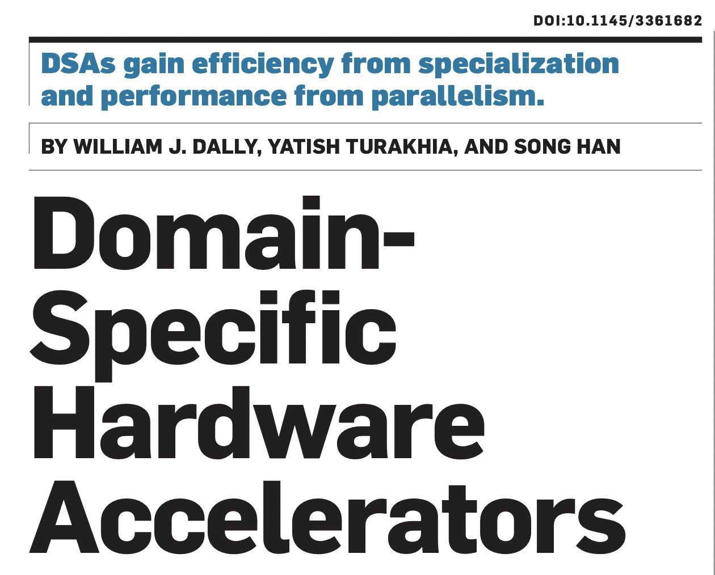
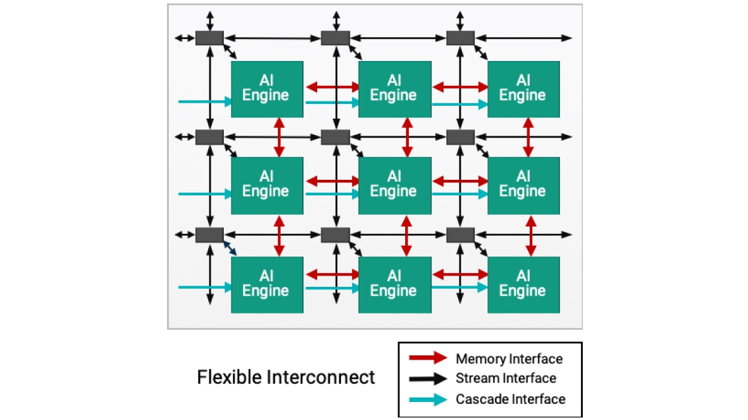
Era of AI Inference Accelerators
Google Tensor
Processing Unit (TPU)
AI accelerator
Specialization:
Designed for a domain
High performance due to massive parallelism
Low power due to design simplicity
Low programmability
AMD AI Engine

Slide 13
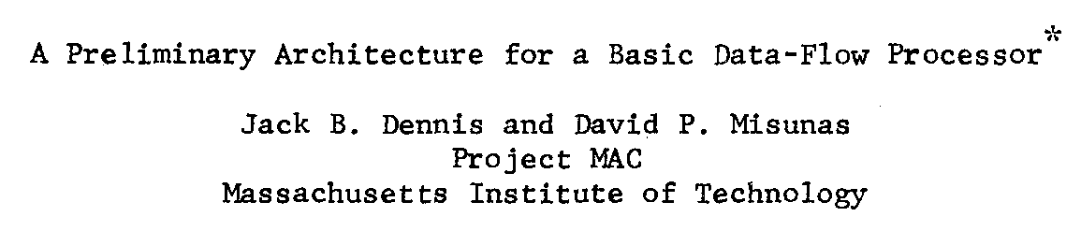
Dataflow Processor
Data
Dataflow Engine
Expose instruction-level parallelism in dataflow graph at compile time
Dataflow graph is directly mapped onto hardware
Operation is triggered when input data is ready
ISCA 1975
+
-
Memory
>>
<<
|
&
-
&
Data
*
13
Data

Slide 14
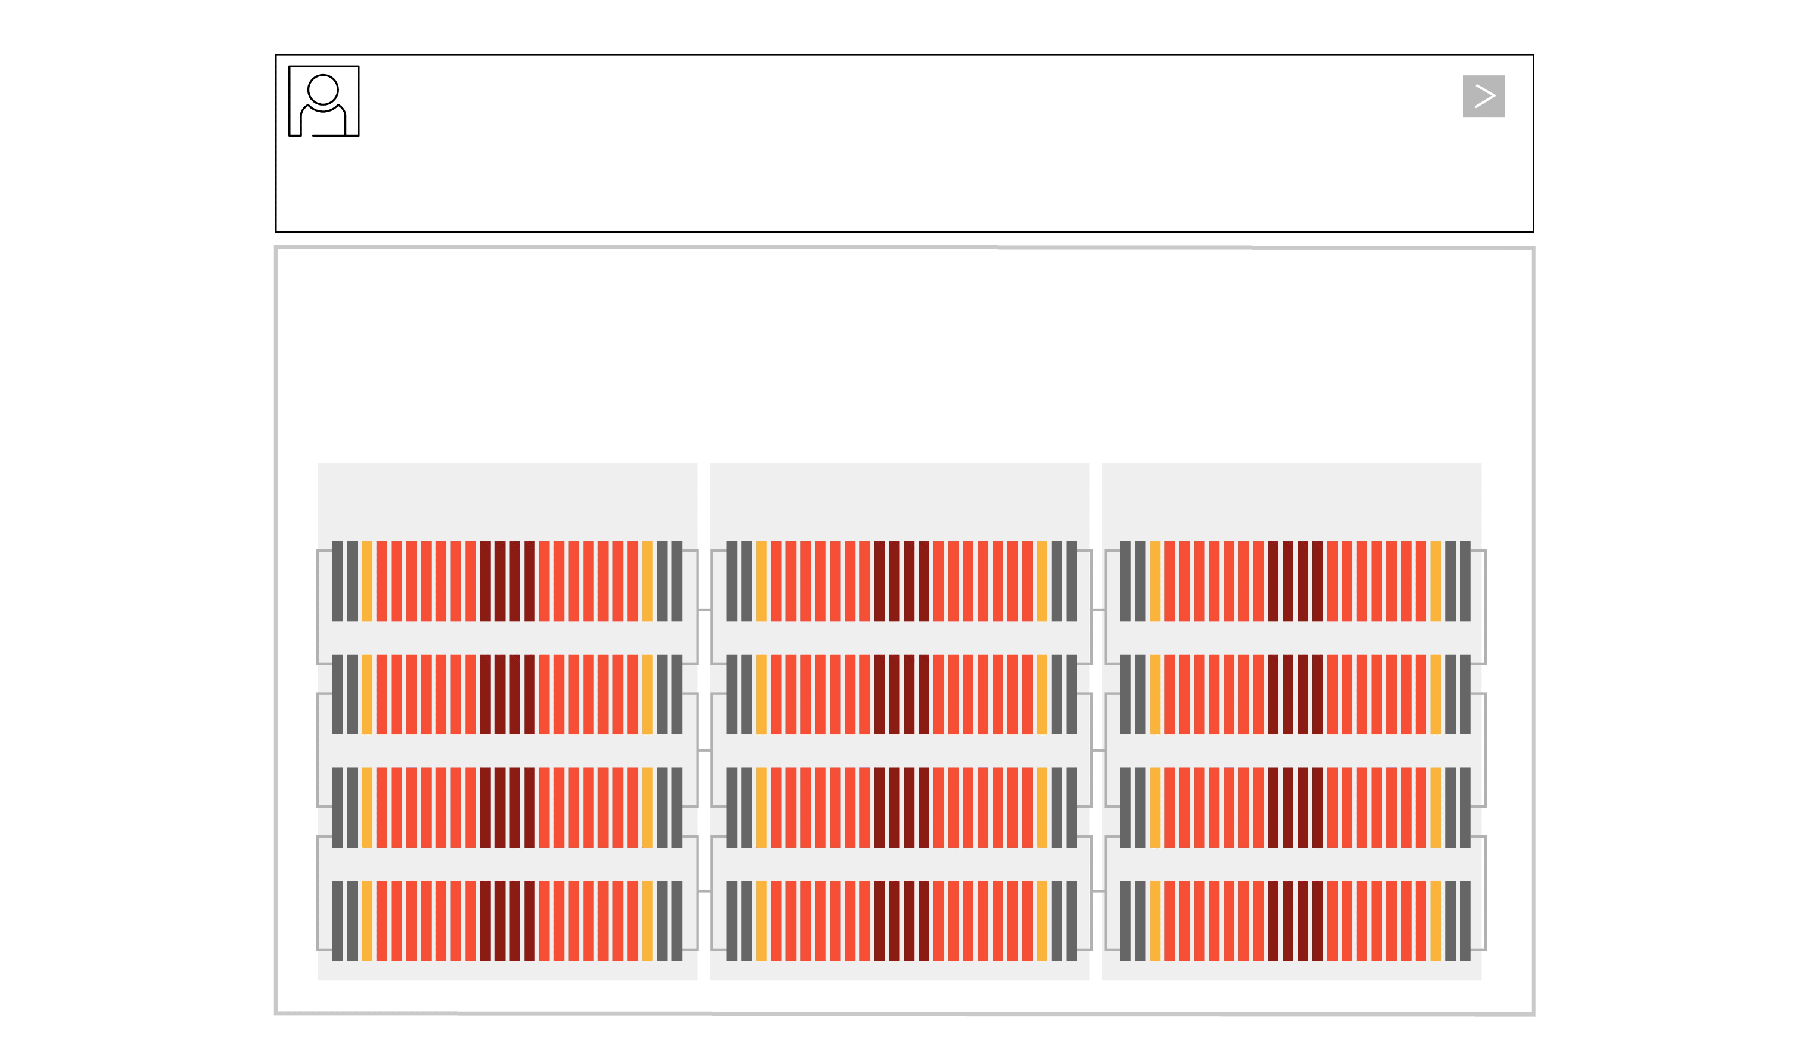
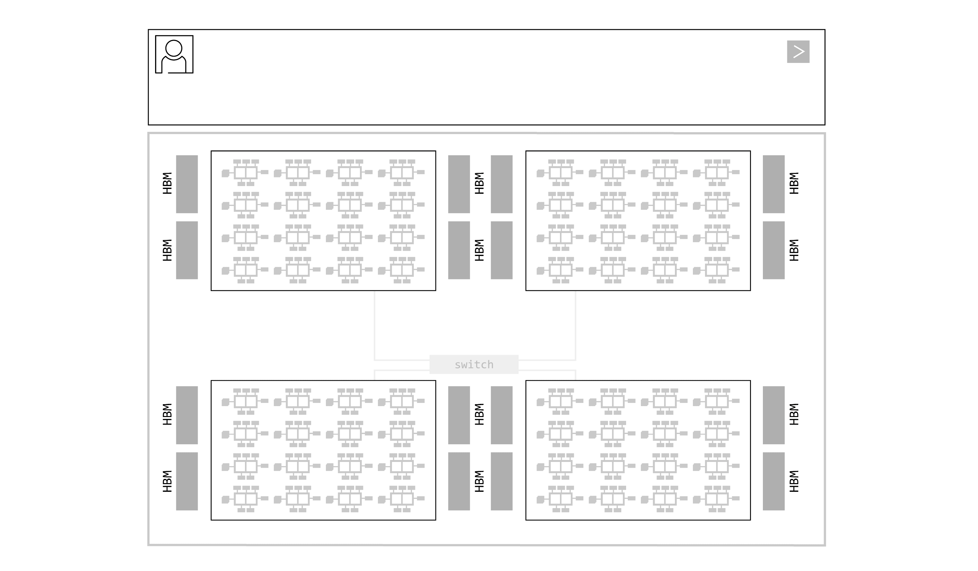
Groq Language Processing Unit (LPU)
Fully software controlled
Programmable Assembly Line Architecture
Deterministic Compute and Networking
Limited on-chip Memory (230MB)
Groq LPU LLM Execution
GPU LLM Execution

Slide 15
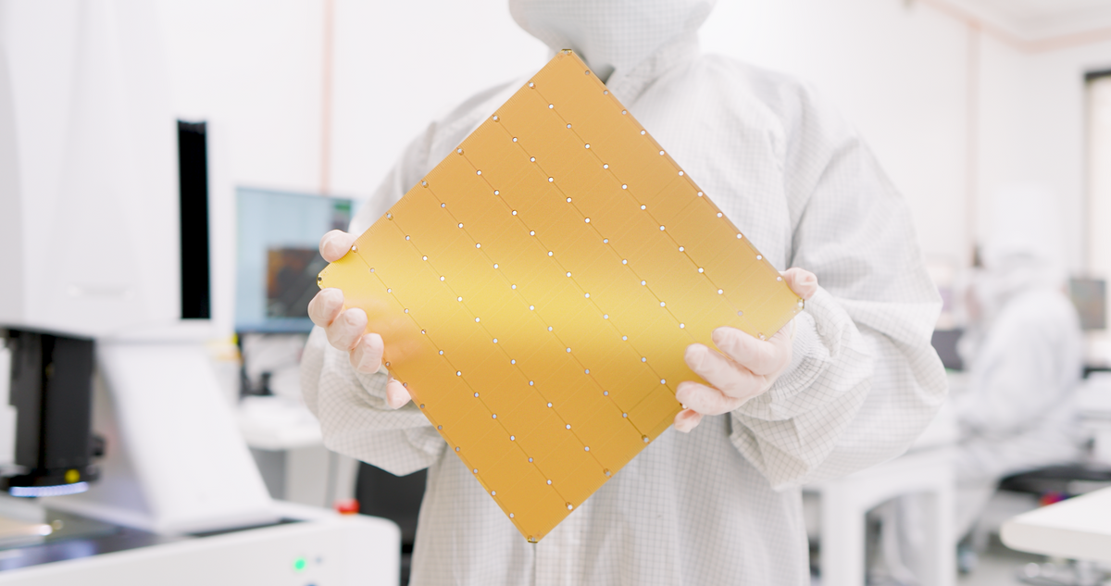
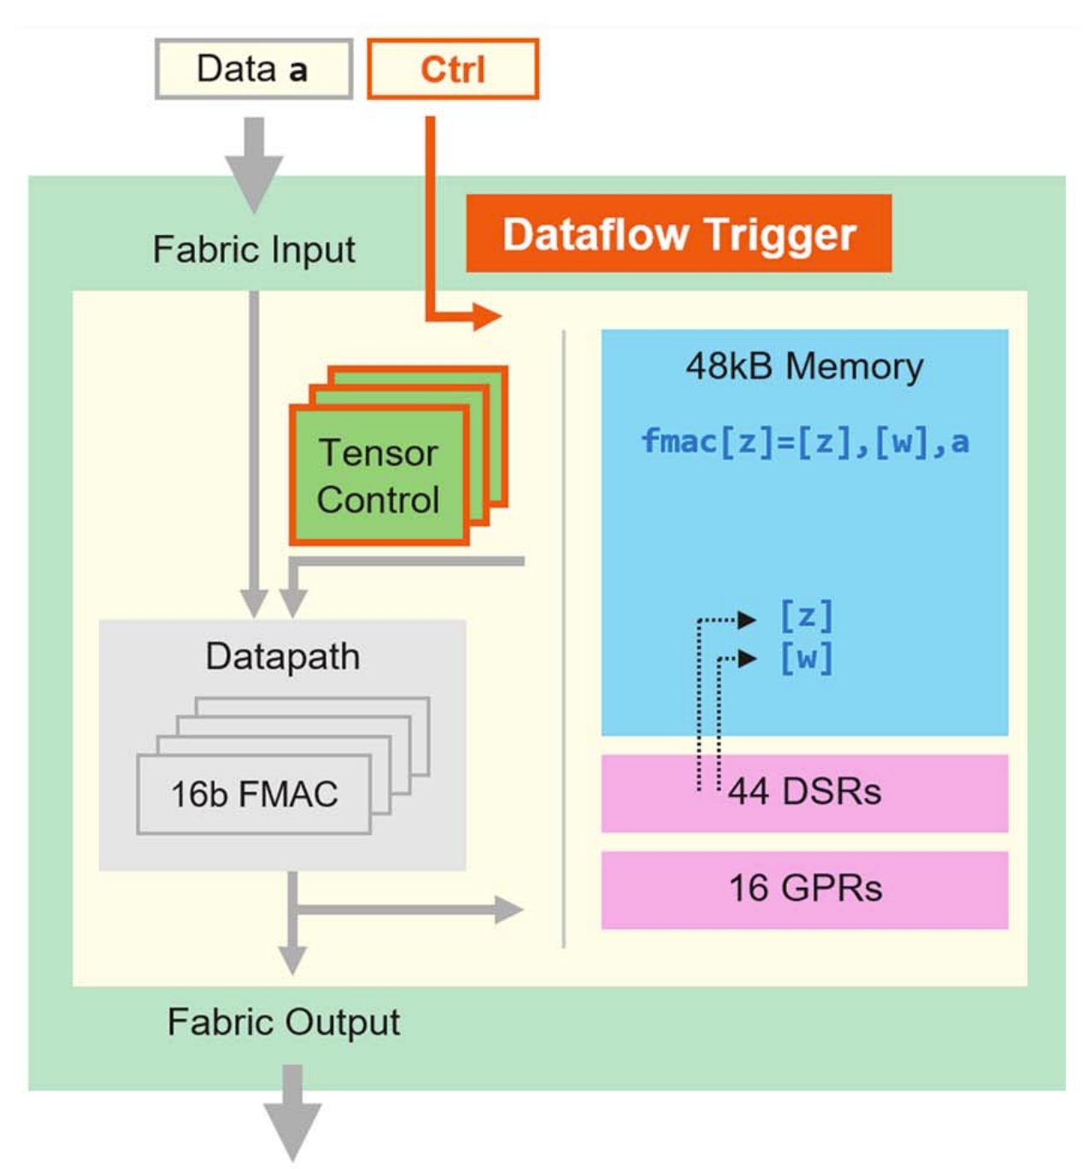
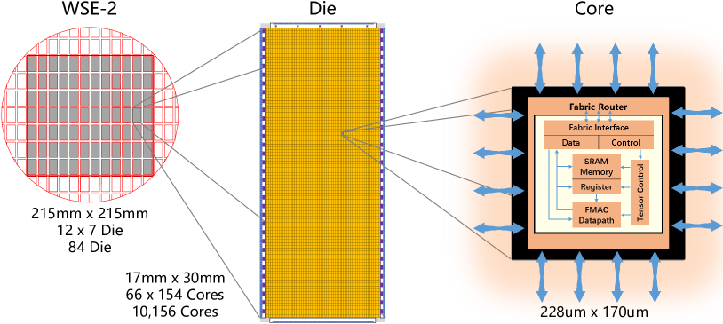
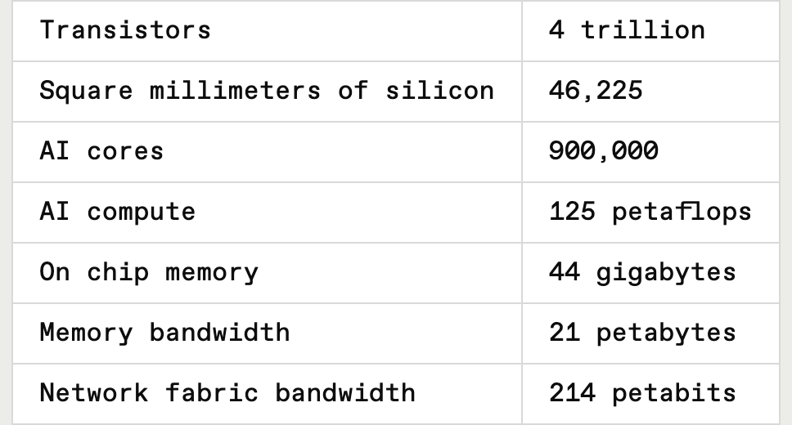
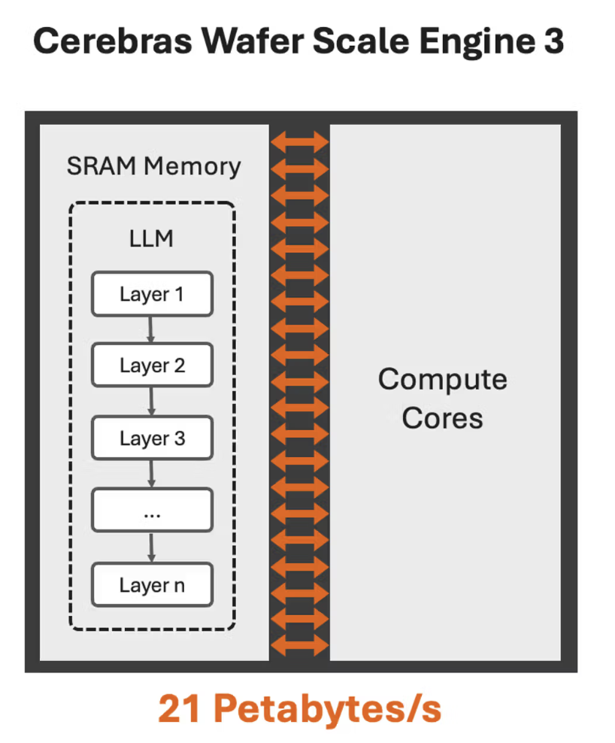
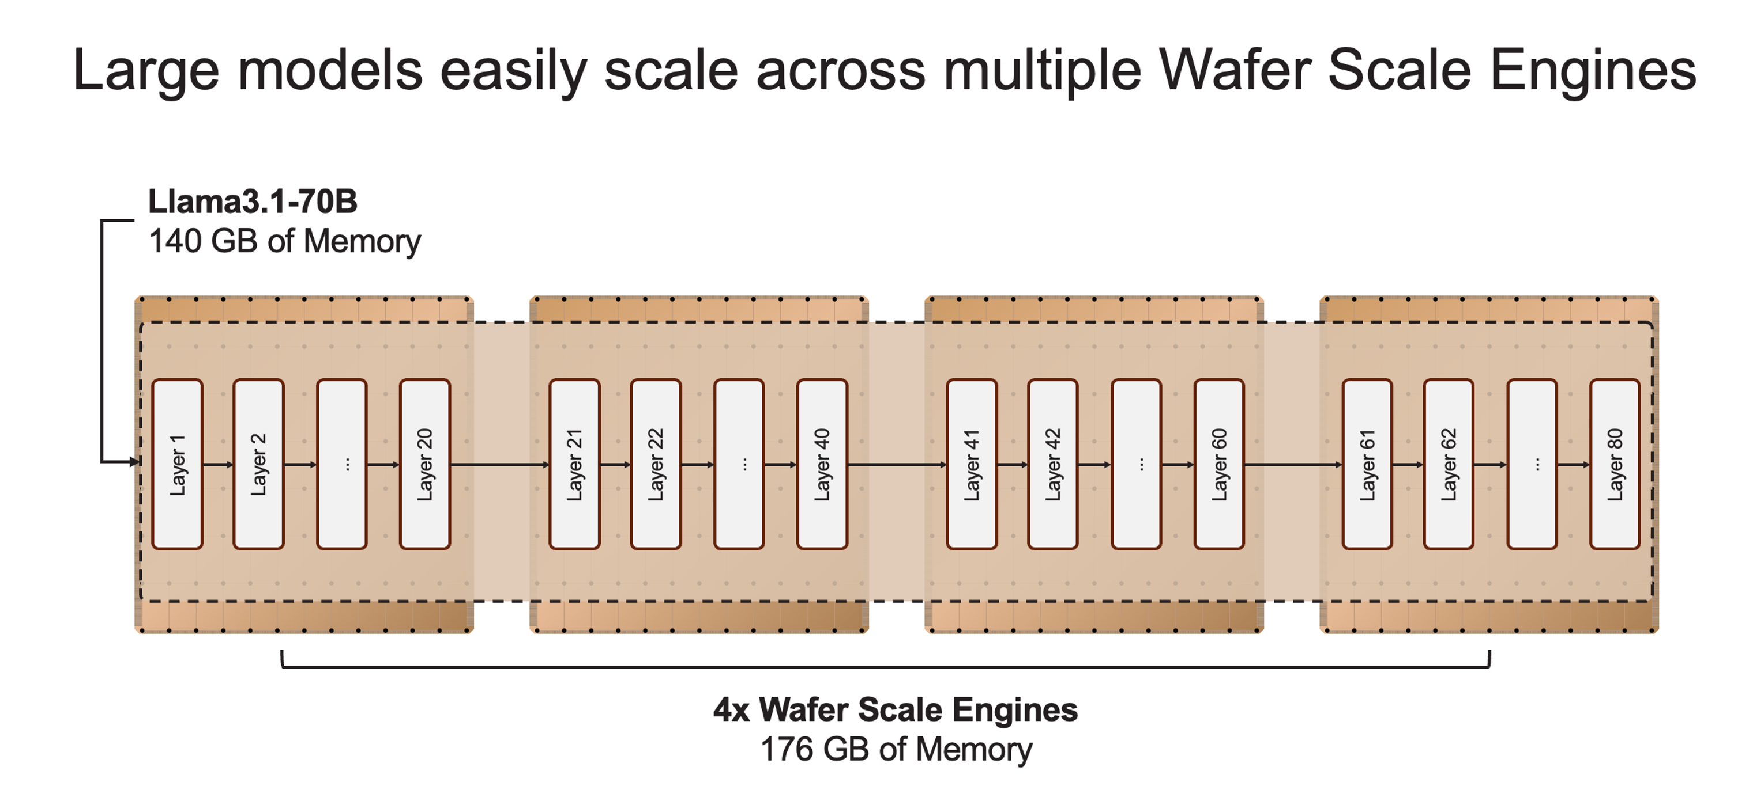
Cerebras Wafer Scale Engine 3 (WSE-3): Massive on-chip SRAM (44GB)

Slide 16
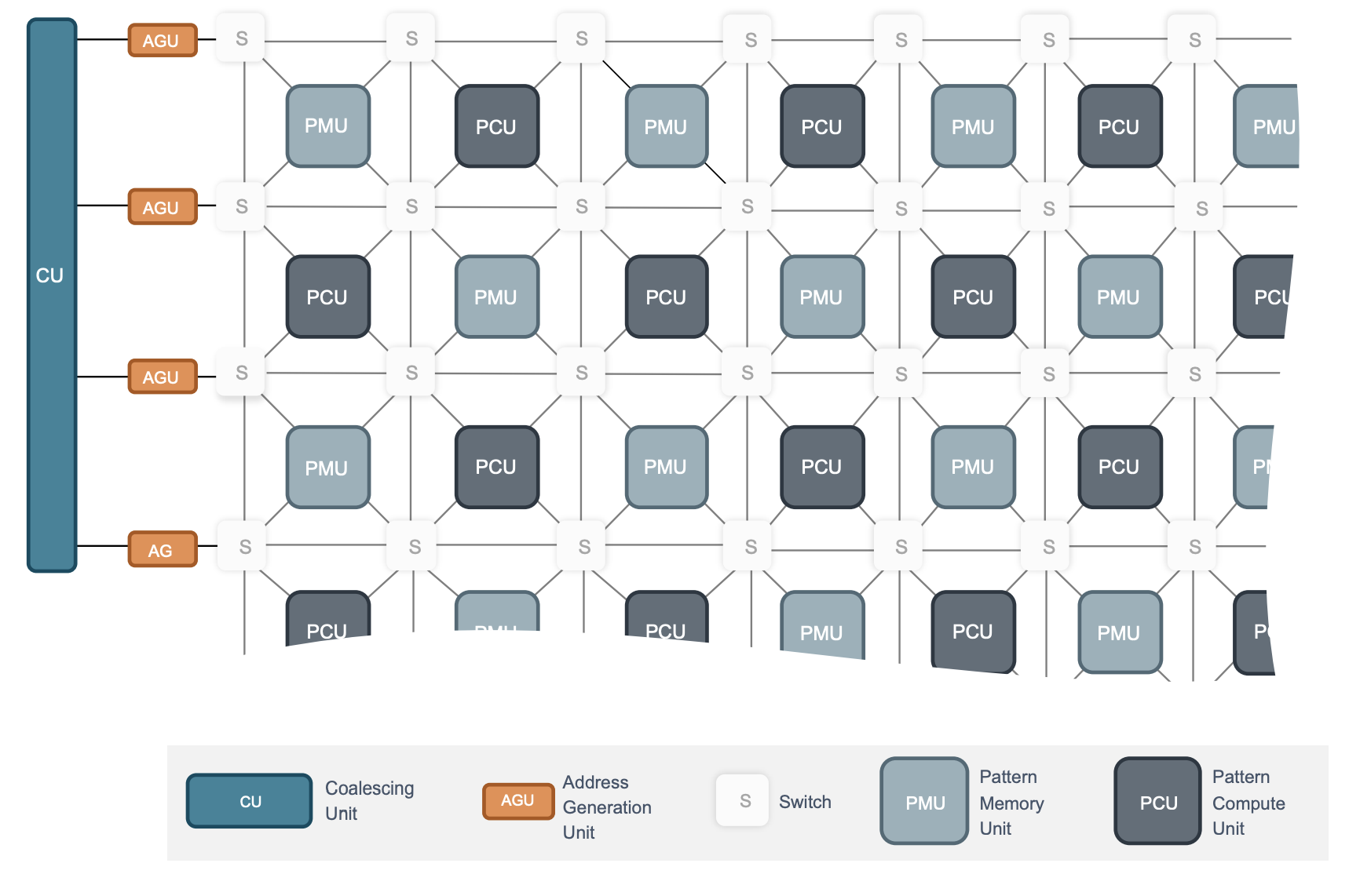
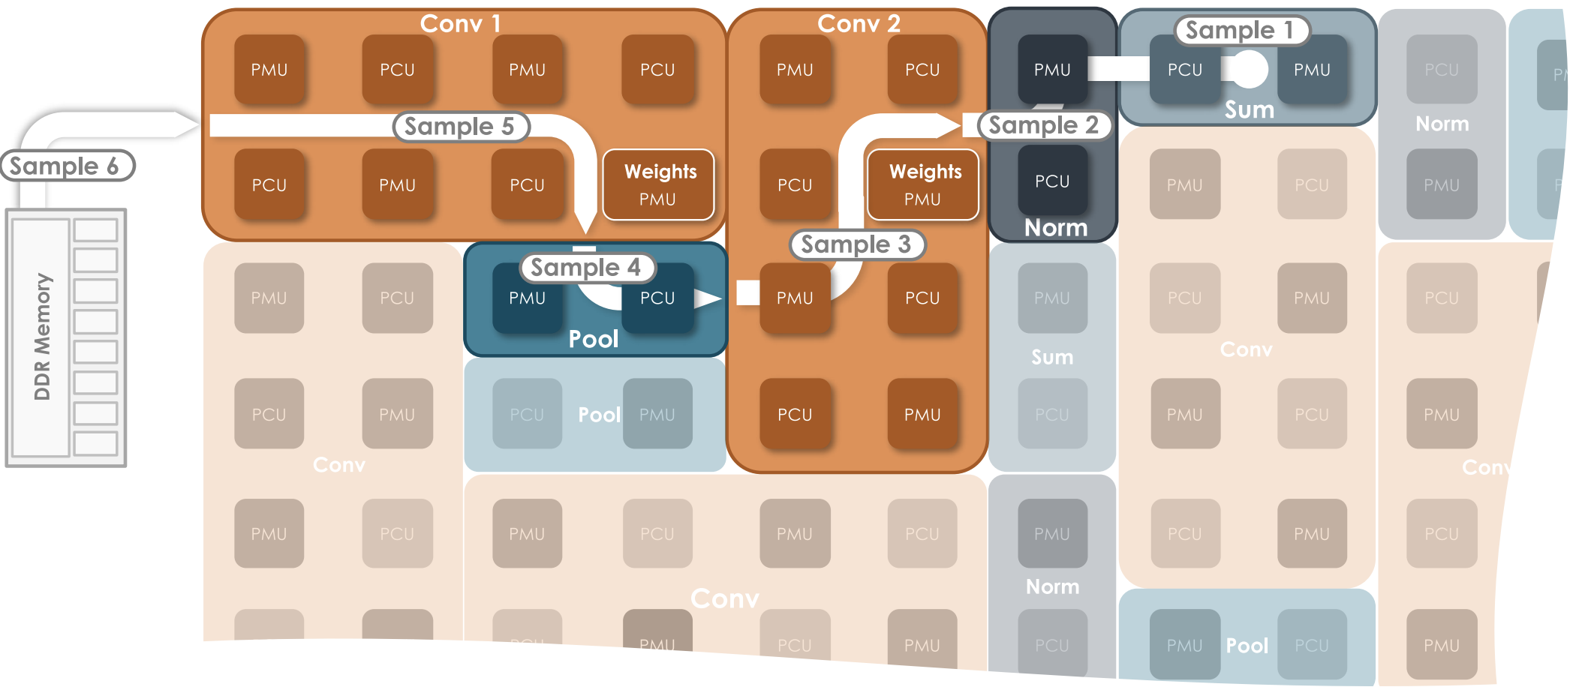
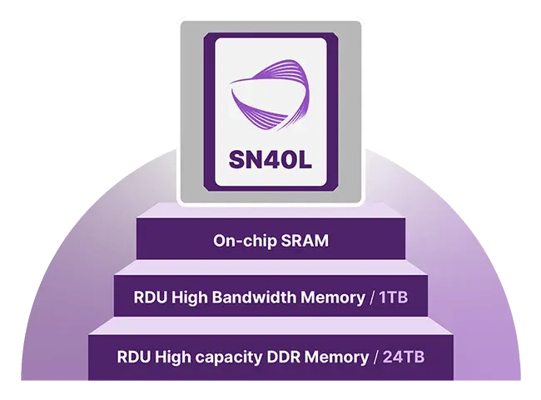
SambaNova Reconfigurable Dataflow Unit (RDU)
Links between tiles can be reconfigured on the fly to facilitate quick data movement

Slide 17
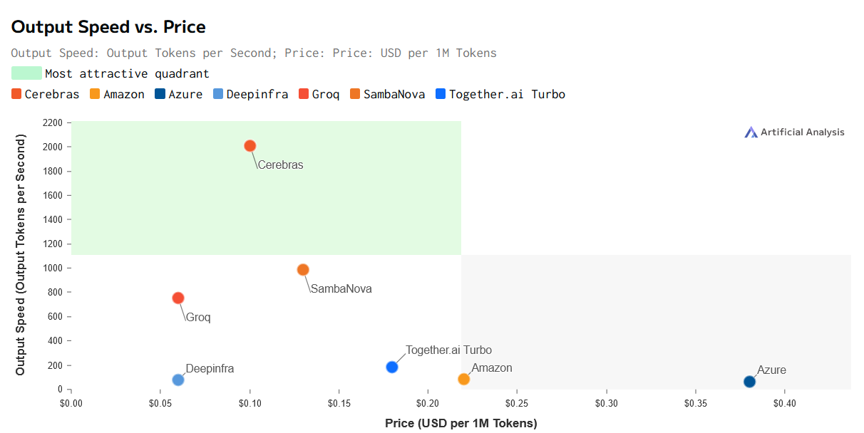
AI accelerators offer faster inference for smaller models
Price vs Speed for Llama-3.1–70B. source: Artificial Analysis

Slide 18
Domain-Specific AI Accelerators Tradeoffs
Application characteristics to benefit from specialization:
Parallelism: Substantial numbers of calculations can be parallelized
Regularity: Computations are stable and arrive at regular intervals
Locality: Relatively few memory accesses are needed per computation
Drawbacks of specialization:
Can only run a limited range of applications
Designing and creating specialized hardware can be expensive
Specialized design cost must be amortized over number of units sold
AI models/optimizations that do not match the specialization suffer

Slide 19
Dream Reconfigurable Accelerator: General yet Special
Software (compiler) instantiates the dataflow corresponding to different applications onto the same hardware
Should appear as easily programmable to software engineers
Performance, energy-efficiency closer to domain-specific accelerators
CGRA: A promising realization of the dream reconfigurable accelerator
Embrace Parallelism
Keep Hardware Simple
Expose to Software

Slide 20
CGRA: Efficiency with Programmability
Parallelism: Array of simple processing elements (PE)
PE operations and routing can be configured per cycle
Exposed to software: Compiler sets the configuration according to dataflow
Simple hardware and hence low power: During execution, PE array and switches simply follow the pre-defined configurations
Global Memory
Bank 0
Bank 1
Bank 2
Bank 3
N
E
S
W
Crossbar
N
N
ALU
R
ALU
R
ALU
R
ALU
R
P
ALU
Instr Mem
Instr Mem
W
Instr Mem
E
Instr Mem
Configuration Memory
I1
I2
Reg File
W
E
S
S
Output Register
ALU
R
ALU
R
ALU
R
ALU
R
Instr Mem
Instr Mem
Instr Mem
Instr Mem
N
E
S
W
Notes:
HyCUBE : A CGRA with Reconfigurable Single-cycle Multi-hop Interconnect Manupa Karunaratne, Aditi Kulkarni, Tulika Mitra, Li-Shiuan Peh 54th ACM/IEEE Design Automation Conference, June 2017
HyCUBE: a 0.9V 26.4 MOPS/mW, 290 pJ/cycle, Power Efficient Accelerator for IoT Applications Bo Wang, Manupa Karunarathne, Aditi Kulkarni, Tulika Mitra, Li-Shiuan Peh IEEE Asian Solid-State Circuits Conference, November 2019

Slide 21
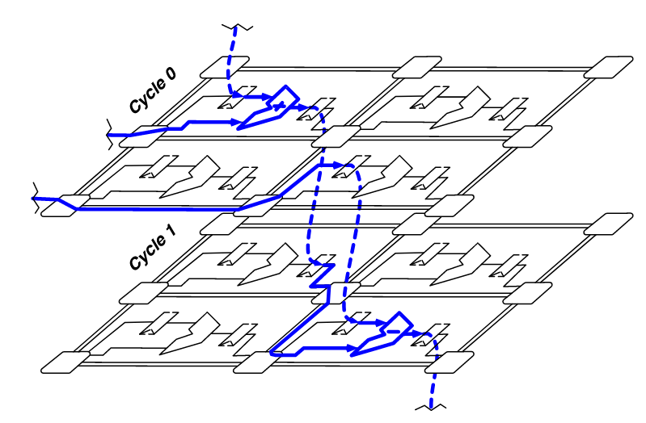
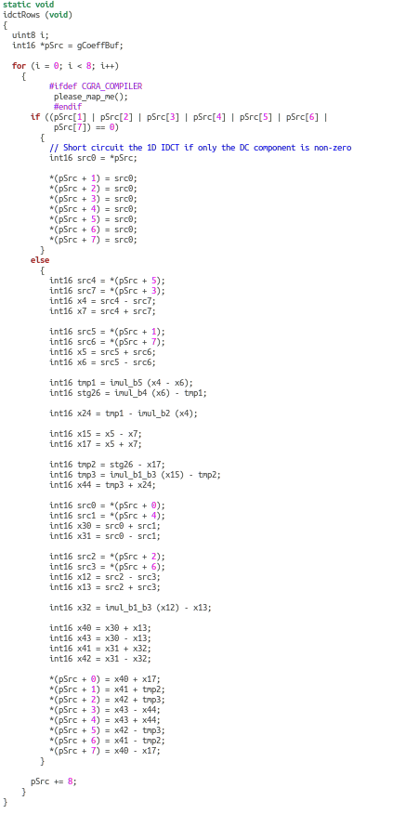
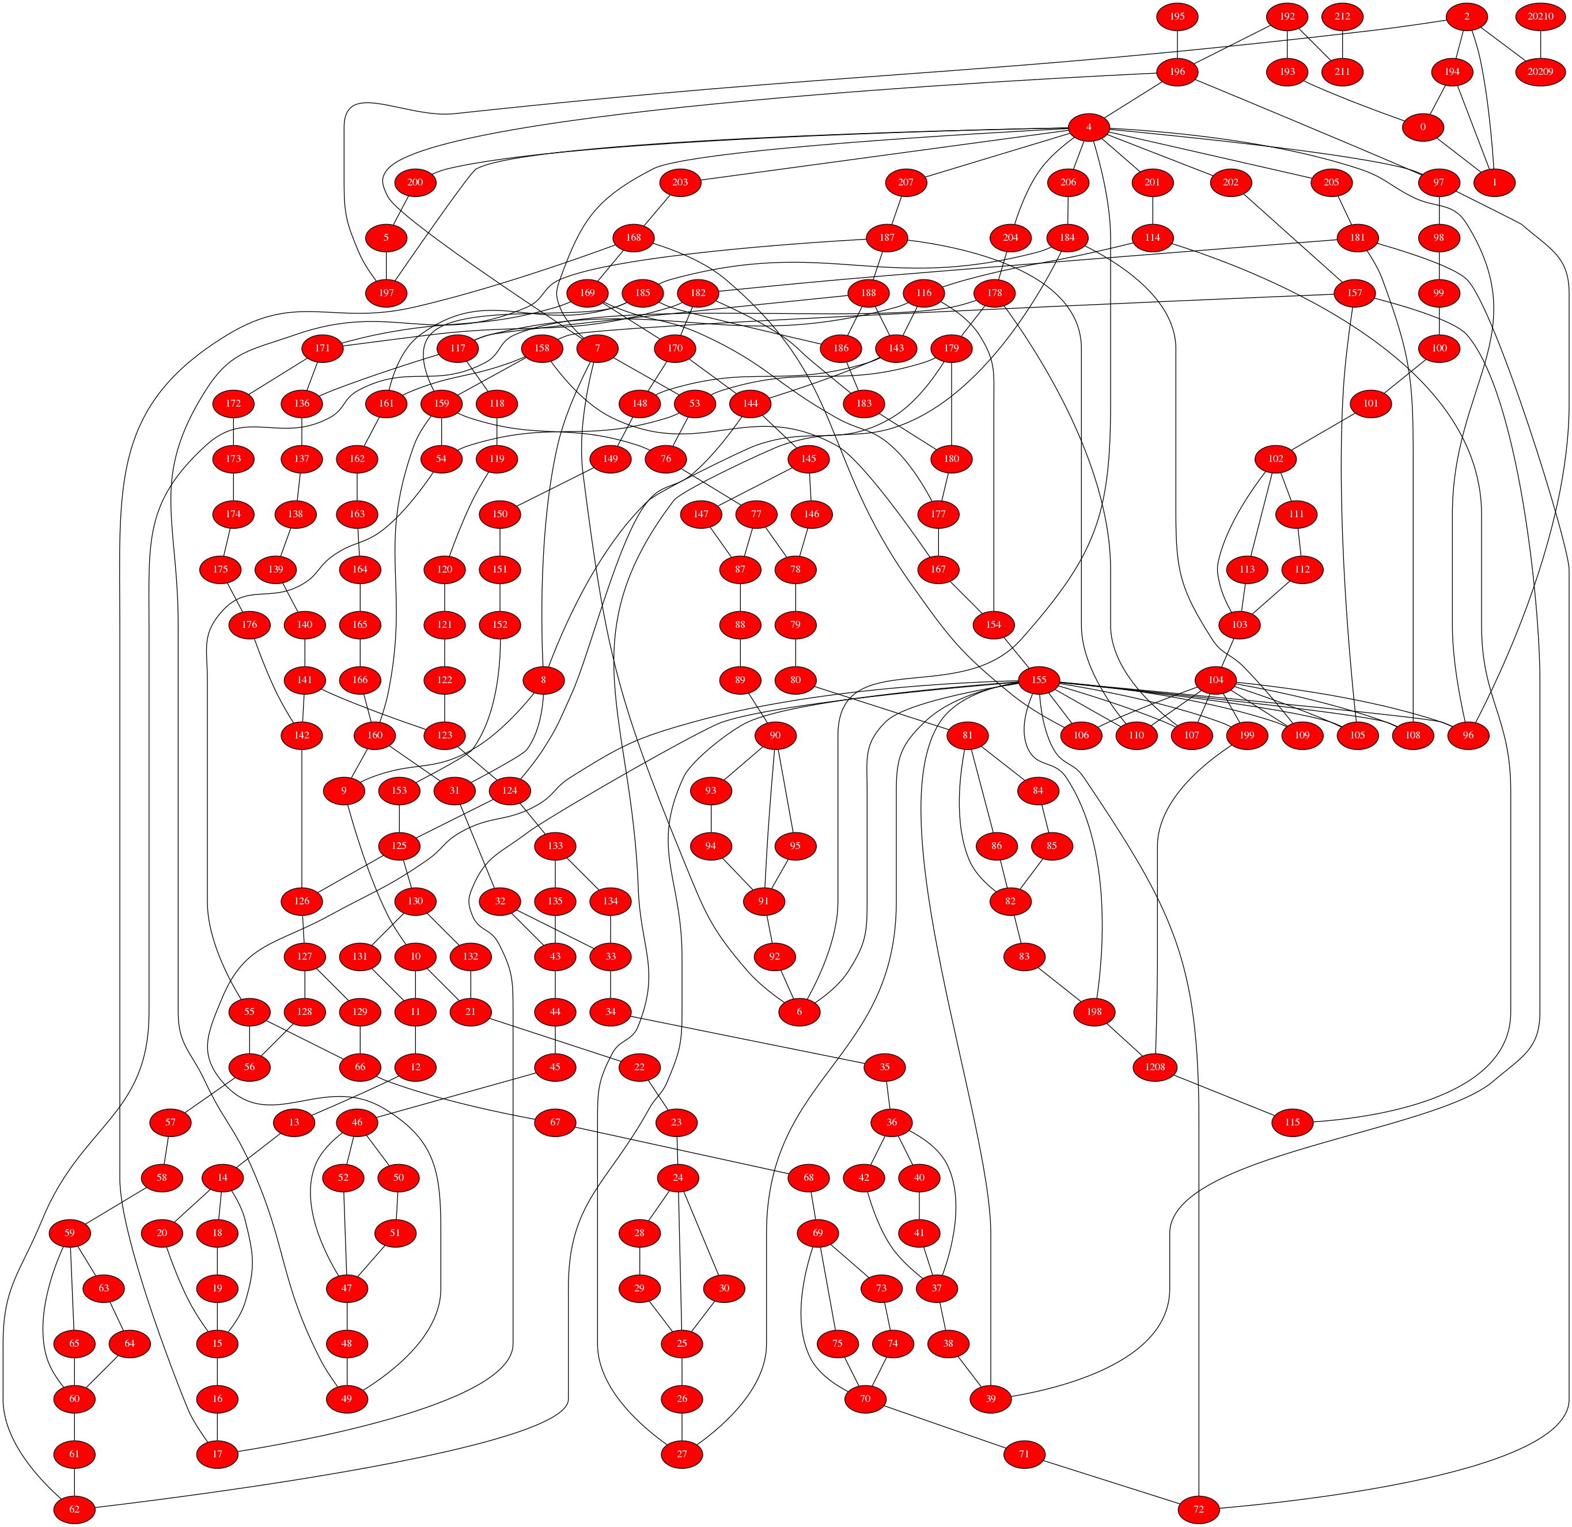
Dataflow synthesis on CGRA
Target: An application-level loop kernel
Mapping the dataflow graph (DFG) of loop body on to CGRA
Placement: assigning DFG operations to ALUs
Routing: mapping data signals using wires and registers
N1
N3
N1
Placement and routing
N2
N3
N1
F2
N4
Cycle 0
F1
F3
F4
DFG
N2
F2
Cycle 1
F1
N3
F3
F4
F1
F2
Cycle 2
F1
F2
N4
F3
F4
Spatio-temporal mapping
F3
F4
Loop kernel c code
Dataflow graph (DFG) of the loop body
2x2 CGRA

Slide 22
HyCUBE CGRA @ NUS
+
+
X
N1
N6
N1
N7
N1
N1
F0
F1
F0
F1
N6
F2
F3
F2
F3
X
-
-
N3
N3
N2
N3
R
R
F0
F1
F0
F1
N4
N5
F2
N5
F3
N2
Reconfigurable single-cycle multi-hop interconnect
Creates large dynamic neighborhood reachable within single-cycle through asynchronous bypassing of intermediate PEs
F2
F3
N7
N4
N7
N4
N1
F0
F1
F0
F1
R
R
N5
N6
F2
N5
F2
F3
F3
F0
F1
N6
N1
N6
F2
F3
HyCUBE: a 0.9V 26.4 MOPS/mW, 290 pJ/cycle, Power Efficient Accelerator for IoT Applications ASSCC’19
HyCUBE : A CGRA with Reconfigurable Single-cycle Multi-hop Interconnect DAC 2017
Conventional CGRA
22
Notes:
HyCUBE : A CGRA with Reconfigurable Single-cycle Multi-hop Interconnect Manupa Karunaratne, Aditi Kulkarni, Tulika Mitra, Li-Shiuan Peh 54th ACM/IEEE Design Automation Conference, June 2017
HyCUBE: a 0.9V 26.4 MOPS/mW, 290 pJ/cycle, Power Efficient Accelerator for IoT Applications Bo Wang, Manupa Karunarathne, Aditi Kulkarni, Tulika Mitra, Li-Shiuan Peh IEEE Asian Solid-State Circuits Conference, November 2019

Slide 23
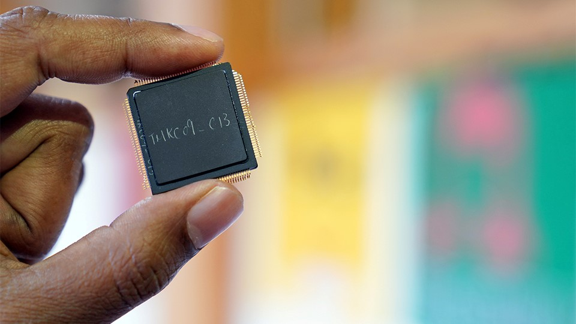
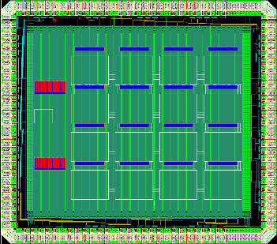
HyCUBE CGRA @ NUS 2019
4x4 CGRA, TSMC 40nm
NUS HyCUBE: 90 MOPS/mW
Samsung SRP: 22 MOPS/mW
ARM CPU: 2.6 MOPS/mW
Xilinx FPGA: 25 MOPS/mW

Slide 24
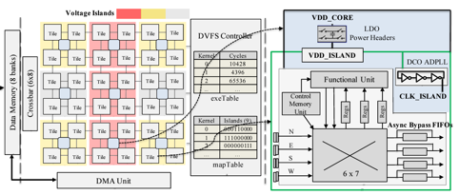
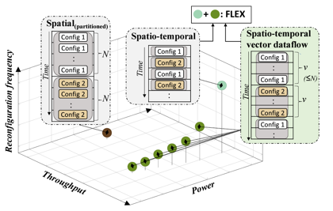
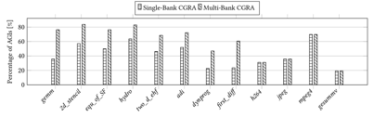
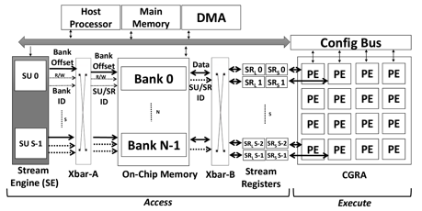
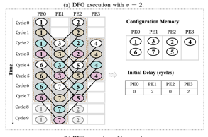
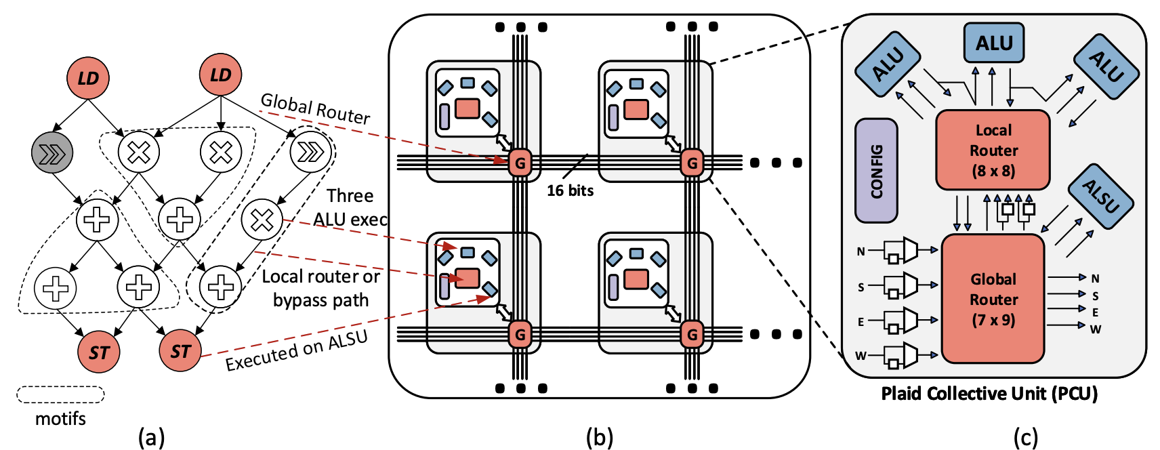
CGRA Architectural Innovations
ICED: DVFS-aware CGRA
1.32x energy-efficiency over CGRA at same performance
CASCADE Decoupled Access-Execute CGRA
3x speedup, 2.2x performance/watt over iso-area CGRA
FLEX: Spatio-temporal vector dataflow
45% less energy. 1.9× power efficiency
at same performance over CGRA
Plaid: Reduced routing provision
43% less power 46% less area
CASCADE: High Throughput Data Streaming via Decoupled Access/Execute CGRA. CASES 2019 FLEX : Introducing FLEXible Execution on CGRA with Spatio-Temporal Vector Dataflow. ICCAD 2023
ICED: An Integrated CGRA Framework Enabling DVFS-Aware Acceleration. MICRO 2024 Plaid: Enhancing CGRA Efficiency Through Aligned Compute and Communication Provisioning. ASPLOS 2025

Slide 25

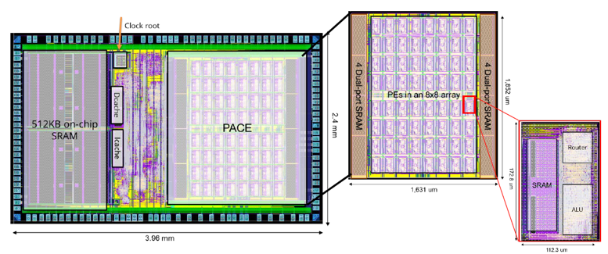
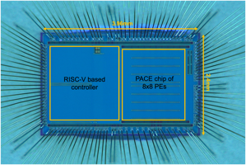
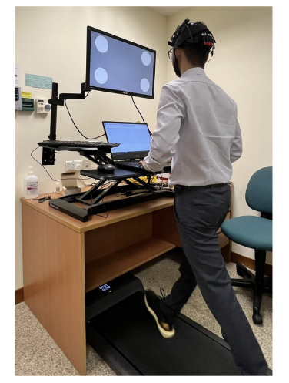




NUS-IME PACE CGRA: SOTA Efficiency
8x8 CGRA: 1.1 mW at 10MHz
582 GOPS/W at 0.45V, 40nm ULP Estimated 1 TOPS/W at 22nm
Wearable EEG
PACE: A Scalable and Energy Efficient CGRA in a RISC-V SoC for Edge Computing Applications. Hot Chips 2024

Slide 26
CGRA Comparison
PACE has highest power efficiency even at 40nm
 | Academic |  |  |  |  |  | Commercial
 | Post synthesis simulation/Post P&R |  |  |  | Silicon |  | Post synthesis simulation/Post P&R | Silicon
CGRA | UE_CGRA HPCA'21 | SNAFU ISCA'21 | TRANSPIRE DATE'20 | RIPTIDE MICRO'22 | AMBER VLSI'22 | PACE | ULP-SRP FPT'12 | Renesas DRP VLSI'18 | Cardinal SN10 (Improved version of Plasticine for ML training) ISSCC'22
PE array | 8x8 | 6x6 |  | 6x6 | 384 PEs | 8x8 | 3x3 | 96 PEs | 640 PMU 640 PCU
Node | 28nm TSMC | Intel 22FFL | 28nm FDSOI | Intel 22FFL | 16nm FINFET | 40nm UMC | 40nm TSMC | 28 nm | 7nm TSMC
Voltage (V) | - | - | 0.6 | - | 1.29 | 0.45 | 1.1 | - | -
Frequency (MHz) | 750 | 50 | 50 | 50 | 955 | 10 | 100 | 333 MHz | -
Area (mm²) | 0.25¹ | 0.27¹ | 0.27 | 0.25¹ | 20.1 | 3.94 | - | - | -
Performance (MOPS) | 625 | 71 | - | 62 | 367000 | 640 | 467² | 960 gigaflops | 2.6 petaflops
Power (mW) | 14 | 0.54 | - | 0.24 | 682 | 1.1 | 11.3 | - | -
Power efficiency (GOPS/W) | 45 | 134 | 224 | 254 | 538 | 582 | 23 | 143³ | -
¹ Only the PE array included
² Estimated from published 467 MIPS
³Estimated value from experiments

Slide 27



Dataflow Synthesis on CGRA
A fertile ground for research
Graph Minor (2012): Theoretically optimal based on graph minor modeling
ChordMap (2020): Streaming dataflow application synthesis
HiMap (2021), Panorama (2022): Scalable mapping through hierarchical abstractions
LISA (2022): Automated compiler synthesis using GNN
Graph Minor Approach for Application Mapping on CGRAs. Best paper award FPT 2012 TRETS 2014
ChordMap: Automated Mapping of Streaming Applications onto CGRA. TCAD 2021 HiMap: Fast and Scalable High-Quality Mapping on CGRA via Hierarchical Abstraction. DATE 2021 TCAD 2022
Panorama: Divide-and-Conquer Approach for Mapping Complex Loop Kernels on CGRA. DAC 2022 LISA: Graph Neural Network based Portable Mapping on Spatial Accelerators. HPCA 2022
Rewire: Advancing CGRA Mapping Through a Consolidated Routing Paradigm. DAC 2025

Slide 28



NUS Morpher Open-Source CGRA Toolchain
Our position paper at ICCAD 2025: Building an Open CGRA Ecosystem for Agile Innovation
Config. Memory
PE
PE
PE
PE
DATA MEMORY
N
N
PE
PE
PE
PE
R
E
ALU
E
PE
PE
PE
PE
Switch
Switch
R
W
DATA MEMORY
W
RF
PE
PE
PE
PE
S
`
S
Abstract
Architecture Model
Basic
Modules(Chisel)
Dataflow Graph
DFG Generation
CGRA
Mapper
Hardware
Generator
Application
source code
with annotated kernel
6
SPM Data Layout
Test
Data Generation
Test data
Mapping
Configurations
Verilog RTL
Simulation
FPGA
Emulation
Area & Power
Estimation
https://github.com/ecolab-nus/morpher

Slide 29

NUS MLIR-Based End-to-End Compiler
End2End compiler that bridges the gap between ML frameworks and the Morpher toolchain by leveraging the power of MLIR (Mult-level intermediate representation).
Support complex applications
Support heterogeneous system (RISC-V & CGRA) compilation
Leveraging MLIR builtin dialects and passes (linalg, std, scf...)

Slide 30
What happens when workload is not dense and regular anymore?
Programmability is solved;
Bottleneck moves to data

Slide 31




Attention is all you need
Attention is the cornerstone of LLMs enabling them to intelligently focus on the most relevant parts of any input
Model weights
KV cache
Vaswani, Ashish. "Attention is all you need.” NeurIPS 2017
Wk
Wq
Wv
Image credit: Damien Benveniste

Slide 32


Self-Attention: Poor Scalability with Context Length
Attention scales poorly with context length, requiring quadratic operations and memory for n tokens

Slide 33

Sparsity in LLM Workloads
Mixture of Experts (MoE): Only a subset of expert modules are activated per token: ~5.5% active parameters in Deepseek-v3 671B
Feed Forward Network
DAOP: Data-Aware Offloading and Predictive Pre-Calculation for Efficient MoE Inference, DATE 2025

Slide 34

Sparsity in LLM Workloads
Mixture of Experts (MoE): Only a subset of expert modules are activated per token: ~5.5% active parameters in Deepseek-v3 671B
Structured sparsity in attention: Sparse attention patterns (e.g., Mistral's sliding window, DeepSeek native sparse attention)
Deepseek Native Sparsity

Slide 35




Structured Sparsity in Attentions
Advanced attention mechanisms leverage diverse sparse matrix computations with specialized patterns for enhanced efficiency
Each type of attention mechanism requires unique dataflow

Slide 36

Sparsity in LLM Workloads
Mixture of Experts (MoE): Only a subset of expert modules are activated per token: ~5.5% active parameters in Deepseek-v3 671B
Structured sparsity in attention: Sparse attention patterns (e.g., Mistral's sliding window, DeepSeek native sparse attention)
Unstructured Sparsity: Individual parameters becoming zero via pruning, activation, or training-time sparsity constraints

Slide 37
We need sparsity for efficiency…
But is the hardware ready?

Slide 38

GPUs Adopted Restricted Structured Sparsity
GPUs cannot deal with unstructured sparsity
Source: Nvidia; Bill Dally

Slide 39



Hardware-Algorithm Gap on TPU and CGRA
Hardware needs structured dataflow,
but AI creates unstructured sparsity
Scattered non-zeros cannot match fixed hardware dataflow
GEMM DFG
2x2 GEMM Computation
PE
PE
PE
PE
PE
PE
PE
PE
PE
PE
PE
PE
PE
PE
PE
PE
Google TPU Matrix Multiply Unit (MXU) Dataflow
HiMap GEMM Schedule & Dataflow on CGRA

Slide 40

SWAT: Architecture following Algorithm
Handcrafted dataflow engine on FPGA for sliding-window attention in LLM
Each token attend to fixed number of predecessors/successor tokens
Reduces the complexity from quadratic to linear
Used in many models: Mistral-7B, DeepSeek MLA, Swin (Vision)
But….efficient implementation on hardware is hard
Naïve GPU implementation is worse than dense due to masking overhead
SWAT: Scalable and Efficient Window Attention-based Transformers Acceleration on FPGAs. DAC 2024

Slide 41

SWAT vs. GPU implementations
Single-batch: Xilinx U55C (16nm) vs. Nvidia A100 (7nm)
SWAT FPGA Sliding-Window Attention achieves 15x energy-efficiency over GPU
Improved execution time on worse technology node
High energy efficiency gain

Slide 42







SADIMM: Sparse Attention Accelerator with DIMM-based Near-memory Processing
SPLIM: Unstructured sparse matrix operations on structured in-situ computing
ASADI: In-memory computing for sparse attention
SADIMM: Accelerating Sparse Attention using DIMM-based Near-memory Processing. IEEE Transactions on Computers 2025 SPLIM: Bridging the Gap Between Unstructured SpGEMM and Structured In-situ Computing. IEEE TCAD 2025
ASADI: Accelerating Sparse Attention using Diagonal-based In-situ Computing. HPCA 2024

Slide 43

Quantized Attention: Reconfigurability Wins
4-bit Mini-Floats provide comparable accuracy to 32-bit FP in transformers
Input
vector
512*int8
GRU
(Attn)
GLU
(FFN)
Output
vector
512*int8
Add &
RMSNorm
Add &
RMSNorm
Complete on-chip storage (BRAM + URAM) of weights on U280 FPGA
MatMult-Free Ternary LLM (1.58bits): 370M parameters: ~5K tokens/sec @ 21W vs. ~100 tokens/sec @ 200W
Shedding the Bits: Pushing the Boundaries of Quantization with Minifloats on FPGAs. FPL 2024 TerEffic: Highly Efficient Ternary LLM Inference on FPGA. arXiV 2025

Slide 44


Unstructured Sparsity is hard
At 4-bit or 8-bit quantization, sparse matrix representation formats used by hardware accelerators (CSR, COO) require more storage than Dense format due to meta-data overhead!!
Sparse storage formats lead to inflation not compression! Bitmap decoding is costly due to long runlength of zeros
ZeD: A Generalized Accelerator for Variably Sparse Matrix Computations in ML. PACT 2024

Slide 45



Taming Unstructured Sparsity: Bit-Tree Format
Storage: Same as ideal bitmap
Fast Decoding: N-passes over N-level Bit-Tree Handles all sparsity level

Slide 46




Taming Unstructured Sparsity: Irregular memory access
ZeD ASIC accelerator achieves 3.2x performance-per-area improvement over SOTA for sparse ML workloads
Gustavson’s Dataflow: Row-wise product
Reorder stationary matrix rows to maximally reuse streaming rows
ZeD: A Generalized Accelerator for Variably Sparse Matrix Computations in ML. PACT 2024

Slide 47

Can one reconfigurable accelerator rule them all?

Slide 48
Toward Efficient Intelligence: Rethinking AI Accelerators for Sparsity
LLMs are growing faster than compute can scale. Sparsity is not optional, it’s essential.
Today’s hardware is fundamentally mismatched with emerging sparse workloads.
Specialized architectures show what’s possible; but we need a universal, reconfigurable accelerator.
Winning the hardware lottery requires co-design: architecture must evolve with algorithms, not after them.

Slide 49





Canon: Data-driven Reconfigurable Accelerator
Algorithm
Orchestrator
Sparsity
Reconfigurable accelerator
Minimalist reconfigurable processing array that adapts to diverse sparsity with minimal reconfiguration cost
Smart algorithm that maps arbitrary dataflows on the fabric
High parallel processing while handling complex dataflow dependencies
A Data-Driven Dynamic Execution Orchestration Architecture. ASPLOS 2026

Slide 50
Cost of Reconfigurability
As data becomes smaller (FP4), instruction cost is very high!
Domain-specific accelerator has minimal config storage and access cost
CGRA accelerator introduces config storage and access cost
Canon achieves efficiency by adapting to workload through a compact data-driven execution orchestrator
Global Memory
CGRA Accelerator
Bank 0
Bank 1
Bank 2
Bank 3
N
E
S
W
Crossbar
N
N
ALU
R
ALU
R
ALU
R
ALU
R
P
ALU
Instr Mem
Instr Mem
W
Instr Mem
E
Instr Mem
Configuration Memory
I1
I2
Reg File
W
E
S
S
Output Register
ALU
R
ALU
R
ALU
R
ALU
R
Instr Mem
Instr Mem
Instr Mem
Instr Mem
N
E
S
W

Slide 51

Data-driven Dynamic Execution Orchestration
Canon achieves efficiency by adapting to workload through a compact data-driven execution orchestrator
Compiler generates FSM for each kernel
FSM generates config that travels through a row (Time-lapsed SIMD)
Sparse Metadata triggers dynamic changes to dataflow

Slide 52


Nexus Machine: Adaptive Message Driven Fabric On-route compute on idle PE
Data-driven execution of irregular workload causes network congestion and load imbalance
DM
DM
DM
DM
DM
ALU
R
ALU
R
ALU
R
ALU
R
SRC
Instr Mem
Instr Mem
Instr Mem
Instr Mem
DM
DM
DM
DM
DM
ALU
R
ALU
R
ALU
R
ALU
R
Instr Mem
Instr Mem
Instr Mem
DST
Network Congestion
Instr Mem
PE Utilization (in %)
PEs along y-dim
PEs along x-dim

Slide 53

Nexus Machine: Adaptive message-driven fabric On-route compute on idle PE
Active Messages carrying both instruction and data trigger compute en-route on idle PE improving load balancing
AM
AM
AM
DM
AM
AM
DM
DM
DM
DM
ALU
R
ALU
R
ALU
R
ALU
R
SRC
Instr Mem
Instr Mem
Instr Mem
Instr Mem
Adaptive Routing
AM
DM
AM
DM
AM
DM
AM
DM
DM
AM
ALU
R
ALU
R
ALU
R
ALU
R
OP
DST
Instr Mem
Instr Mem
Instr Mem
Instr Mem
Compute en-route on idle PE
PE Utilization (in %)
PEs along y-dim
PEs along x-dim
Nexus Machine: 𝐀𝐧 𝐀𝐜𝐭𝐢𝐯𝐞 𝐌𝐞𝐬𝐬𝐚𝐠𝐞 𝐈𝐧𝐬𝐩𝐢𝐫𝐞𝐝 𝐑𝐞𝐜𝐨𝐧𝐟𝐢𝐠𝐮𝐫𝐚𝐛𝐥𝐞 𝐀𝐫𝐜𝐡𝐢𝐭𝐞𝐜𝐭𝐮𝐫𝐞. MICRO 2025

Slide 54



Reconfiguration offers reliability, sustainability benefits!
Embodied footprint: Raw material extraction, manufacturing, assembly, transportation, end-of-life processing Operational footprint: Device use during its entire lifetime
Embodied footprint dominated most consumer computing devices
CGRA accelerators circumvents faults
Carbon footprint saving by replacing SoC IP blocks with CGRA
Sustainable Hardware Specialization, ICCAD 2024

Slide 55

Data-Driven Reconfigurable Accelerator
Then: GPU won by becoming general-purpose from a graphics chip (architecture + CUDA + tools)
Now: GPU Tensor Cores → Dense AI focus
Next: Data-driven reconfigurable execution as the new general-purpose
Payoff: Default fabric of the 2030s with near-ASIC perf/W

Slide 56


















PACE Programme: A synergistic Cross-Layer Approach
Real-world Application
Development of efficient & flexible next-generation software-defined accelerator for edge computing
1
2
3
Human/Object detection and tracking
Human/Object Semantic Understanding
Navigation, biometrics
Application Driver and Optimizations
Dataflow Computing Model
Accelerator Architecture
Gim-Hee Lee, NUS
Pham-Nam Trung, I²R
Tulika Mitra, NUS
Li-Shiuan Peh, NUS
PACE Architecture
Dataflow
Model
Compiler
4
5
Application
Code
Deep Neural
Network Model
Synthesis of Application on Accelerator
Circuits
Optimizations for the Accelerator
PACE chip
on wearable glass
Tulika Mitra, NUS
Anh Tuan Do, IME
National Research Foundation Singapore Competitive Research Programme (NRF-CRP) ~$6M for 5 years PACE: Next-Generation IoT Edge Computing through Efficient Software Programmable Accelerators

Slide 57


GAIA: Rethinking data centre computation and communication design for Green AI
Achieve sustainable AI with energy-efficient sparse architecture
$9.2M Funding from Ministry of Education Singapore: July 2025-2030
Lead PI
Tulika Mitra, Provost’s Chair Professor, NUS Computing
Collaborator: AMD Research & Advanced Development: Singapore, USA, Ireland
Prof. Gustavo Alonso, ETH Zurich Prof. Lieven Eeckhout, Ghent Univ.
Team PI
Trevor Carlson, Assistant Professor, NUS Computing
Bingsheng He, Professor, NUS Computing
Jialin Li, Assistant Professor, NUS Computing
Li-Shiuan Peh, Provost’s Chair Professor, NUS Computing

Slide 58




Thank You
Li-Shiuan Peh
Pranav Dangi
Zhenyu Bai
Rohan Juneja
dangi@nus.edu.sg
zhenyu.bai@nus.edu.sg
rohan@comp.nus.edu.sg
We are Hiring!

Slide 59






Acknowledgments
Anh Tuan Do
Chen Liang
Tan Cheng
Manupa Karunaratne
Wang Bo
Aditi Kulkarni
Dhananjaya Wijerathne
Zhaoying Li
Thilini Kaushalya Bandara
Dan Wu
Vishnu Paramasivam
Chong Yi Sheng

